Slide 1
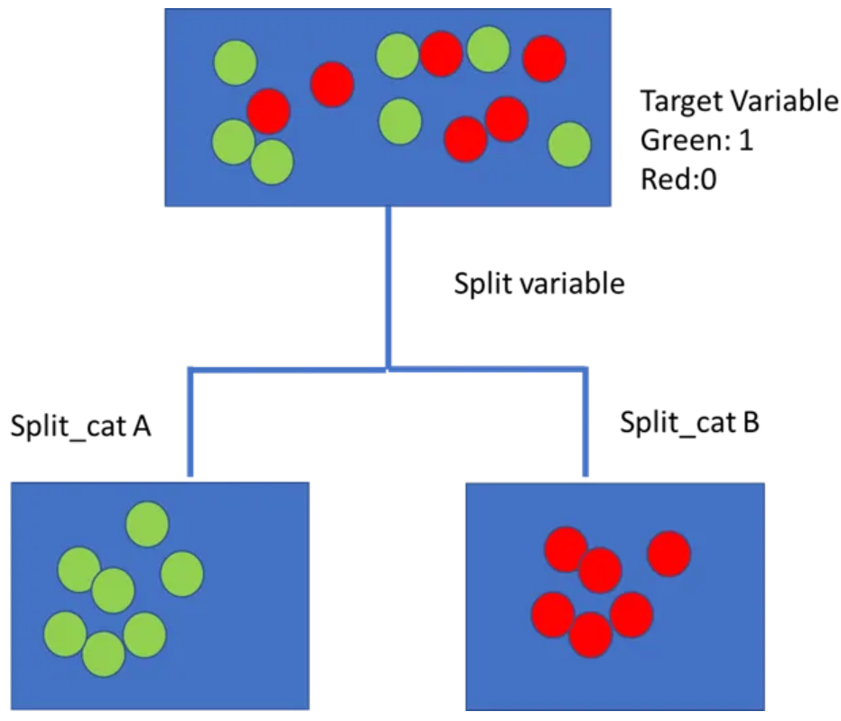
Decision Tree
The first thing to understand in Decision Trees is that they split the predictor space, i.e., the target variable into different sub groups which are relatively more homogenous from the perspective of the target variable. For example, if the target variable is binary, with categories 1 and 0 ( shown by green and red dots in the image below, then the decision tree works to split the target variable space into sub groups that are more homogenous in terms of having either 1’s or 0’s.

Slide 2
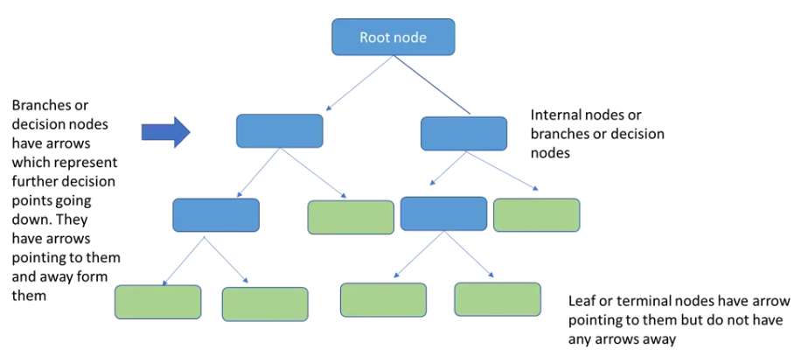
Understanding components of a Decision Tree
A decision tree is a branching flow diagram or tree chart. It comprises of the following components:
A target variable such as diabetic or not and its initial distribution.
A root node: this is the node that begins the splitting process by finding the variable that best splits the target variable
Node purity: Decision nodes are typically impure, or a mixture of both classes of the target variable (0,1 or green and red dots in the image). Pure nodes are those that have one class — hence the term pure. They either have green or red dots only in the image.
Decision nodes: these are subsequent or intermediate nodes, where the target variable is again split further by other variables
Leaf nodes or terminal nodes are pure nodes, hence are used for making a prediction of a numerical or class is made.

Slide 3
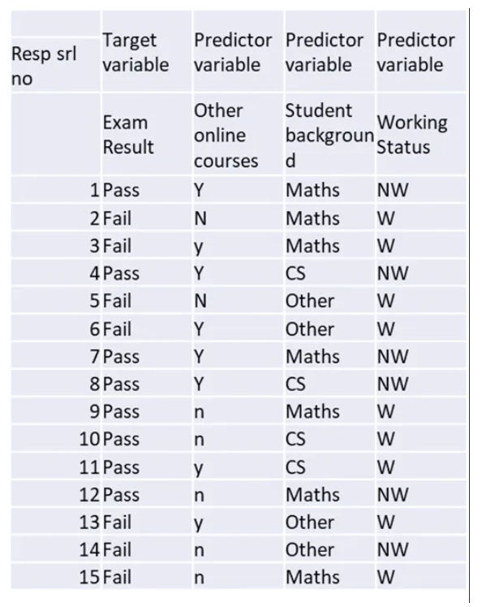
Problem
We have data for 15 data points of student data on pass or fail an online ML exam. To understand the basic process we begin with a dataset which comprises a target variable that is binary ( Pass/Fail) and various binary or categorical predictor variables such as:
Whether enrolled in other online courses
Whether student is from a maths, computer science or other background
Whether working or not working
Notice that only one variable, ‘Student Background’ has more than 2 levels or categories — Maths, CS, Others. It is one for the advantages of Decision Trees compared to other classification models such as Logistic Regression or SVM, that we do not need to carry out one hot encoding to make these into dummy variables.

Slide 4
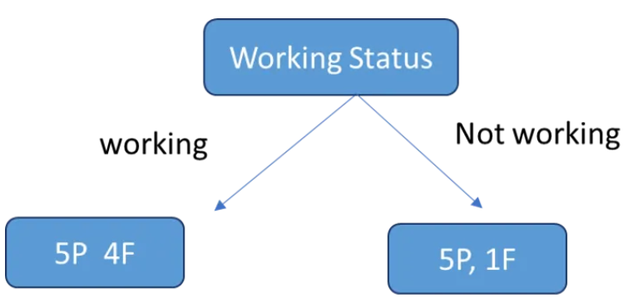
Flow of Decision Tree
A decision tree begins with the target variable. This is usually called the parent node. The Decision Tree then makes a sequence of splits based in hierarchical order of impact on this target variable. From the analysis perspective the first node is the root node, which is the first variable that splits the target variable.
To identify the root node we would evaluate the impact of all the variables that we have currently on the target variable to identify the variable that splits the exam Pass/Fail classes into the most homogenous groups. Our candidates for splitting this are: Background, Working Status and Other Online Courses.
What do we hope to achieve with this split? Suppose we begin with Working Status as the root node. This splits into 2 sub nodes, one each for Working and Not working. Thus the Pass/Fail status is updated in each sub node respectively.
So, this is the basic flow of the Decision Tree. As long as there is a mixture of Pass and Fail in a sub node, there is scope to split further to try and get it to be only one category. This is termed the purity of the node. For example, Not Working has 5 Pass and 1 Fail, hence it is purer than the Working node which has 5P and 4F. A leaf node would be one which contains either Pass or Fail class only.
A node which is impure can be branched further for improving purity. However, most of the time we do not necessarily go down to the point where each leaf is ‘pure’. It is also important to understand that each node is standalone and hence the attribute that best splits the ‘Working’ node may not be the one that best splits the ‘Not Working’ node.

Slide 5
Greedy top down approach
Decision trees follow a top-down, greedy approach that is known as recursive binary splitting. The recursive binary splitting approach is top-down because it begins at the top of the tree and then it successively splits the predictor space. At each split the predictor space gets divided into 2 and is shown via two new branches pointing downwards. The algorithm is termed is greedy because at each step of the process, the best split is made for that step. It does not project forwards and try and pick a split that might be more optimal for the overall tree.
The algorithm therefore evaluates all variables on some statistical criteria and then chooses the variable that performs best on the criteria.

Slide 6
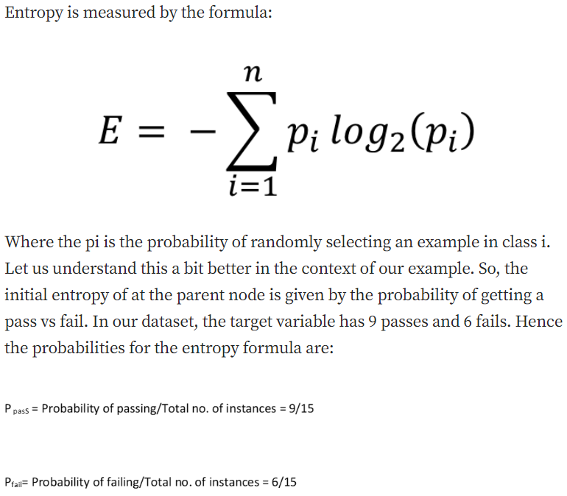
Variable Selection Criteria
Entropy-
Entropy is a term that comes from physics and means a measure of disorder. In the context of Decision Trees, entropy is a measure of disorder or impurity in a node. Thus, a node with more variable composition, such as 2Pass and 2 Fail would be considered to have higher Entropy than a node which has only pass or only fail. The maximum level of entropy or disorder is given by 1 and minimum entropy is given by a value 0.
Leaf nodes which have all instances belonging to 1 class would have an entropy of 0. Whereas, the entropy for a node where the classes are divided equally would be 1.

Slide 7
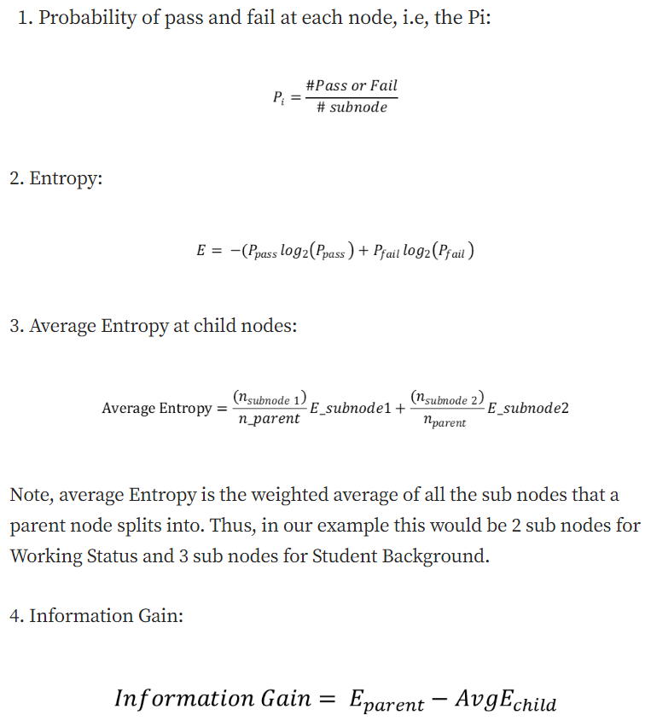
Variable Selection Criteria
Now essentially what a Decision Tree does to determine the root node is to calculate the entropy for each variable and its potential splits. For this we have to calculate a potential split from each variable, calculate the average entropy across both or all the nodes and then the change in entropy vis a vis the parent node. This change in entropy is termed Information Gain and represents how much information a feature provides for the target variable.
Entropy_parent is the entropy of the parent node and Entropy_children represents the average entropy of the child nodes that follow this variable. In the current case since we have 3 variables for which this calculation must be done from the perspective of the split.
1. Work Status
2. Online Course Status
3. Student Background
To calculate entropy, first let us put our formulas for Entropy and Information Gain in terms of variables in our dataset:

Slide 8
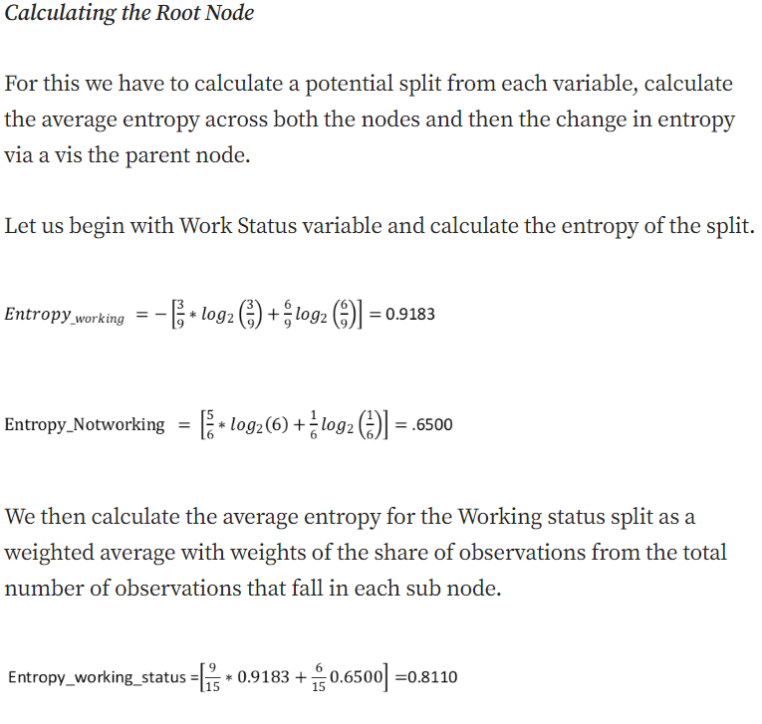
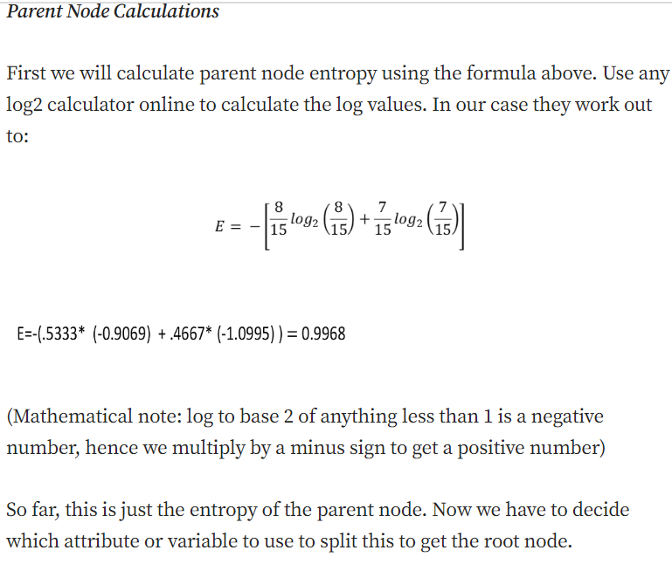
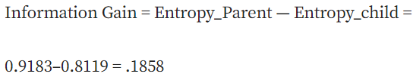

Slide 9
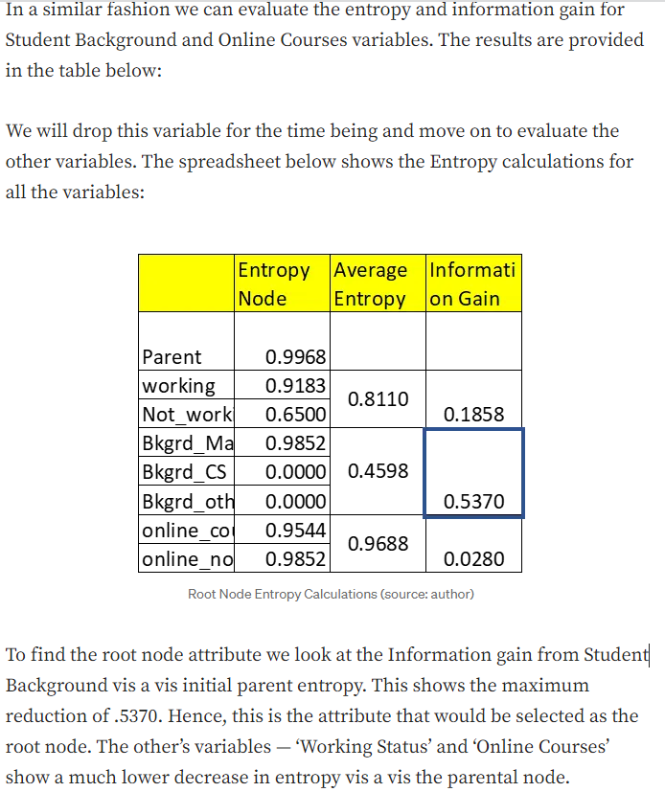
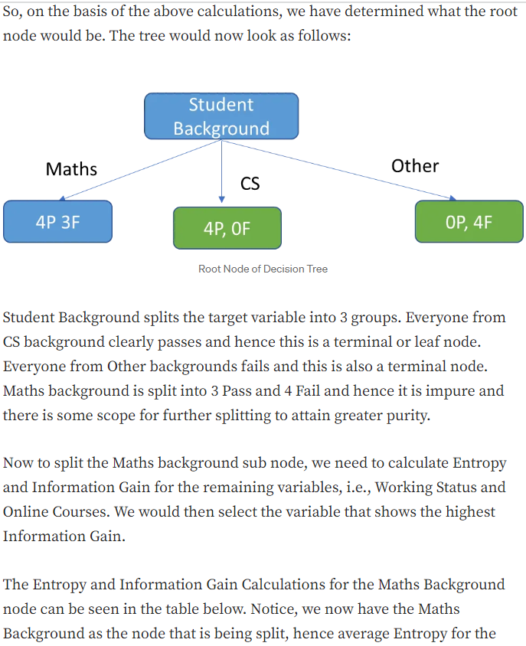

Slide 10
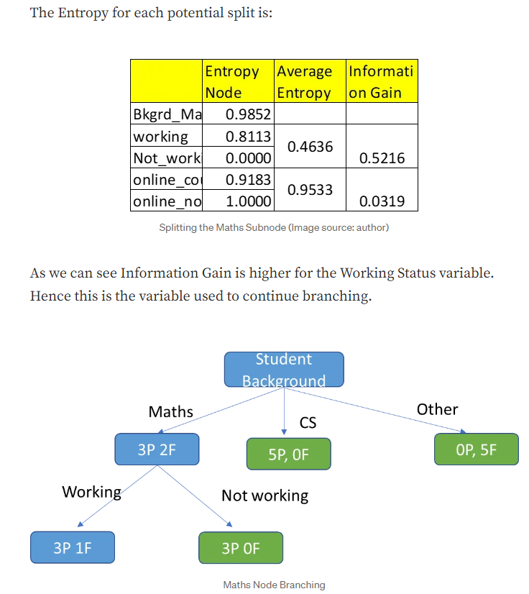
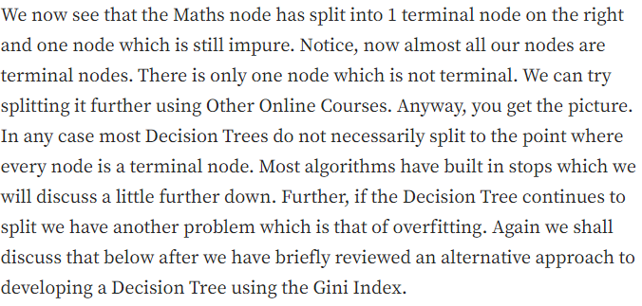

Slide 11
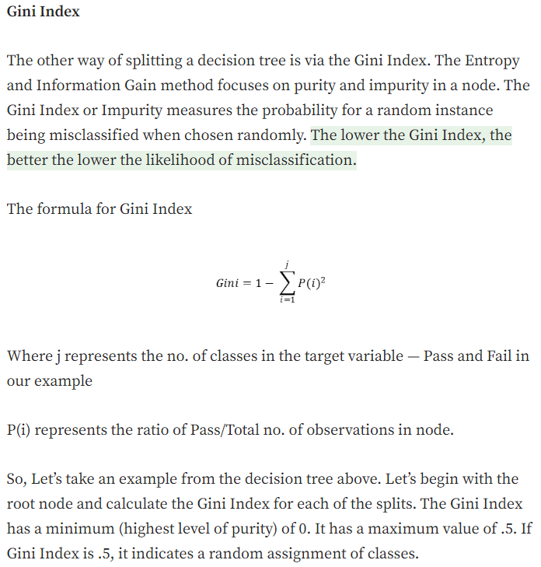
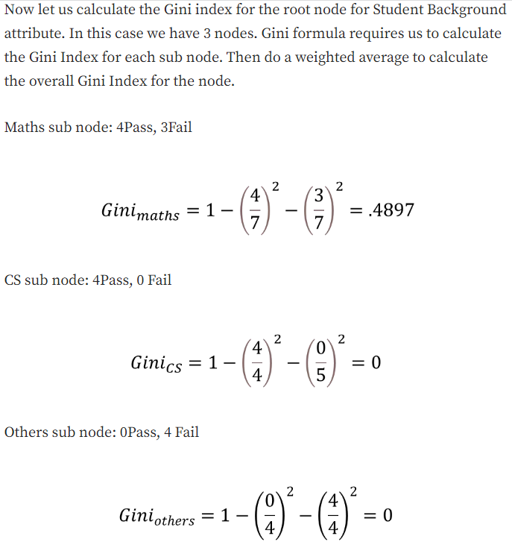
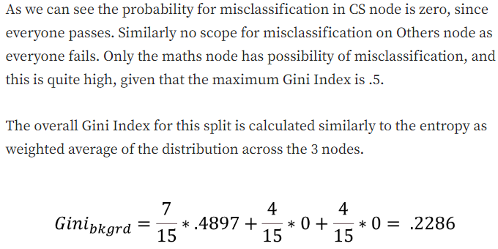
GINI Index

Slide 12
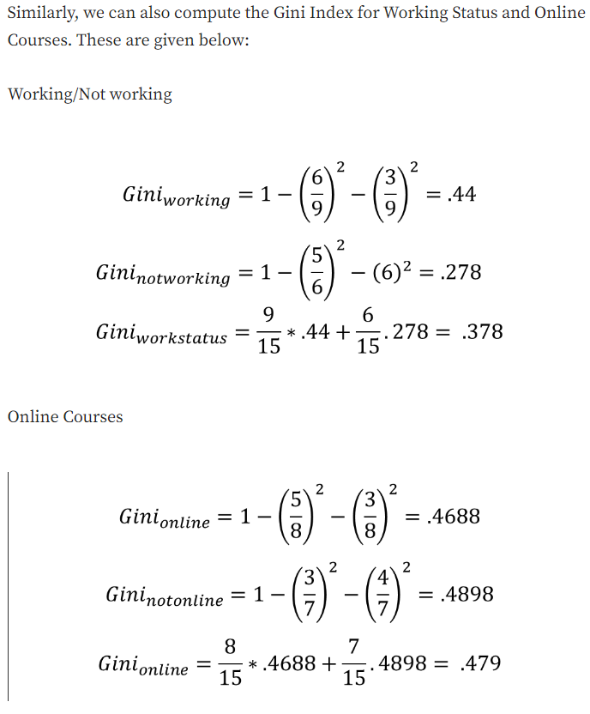
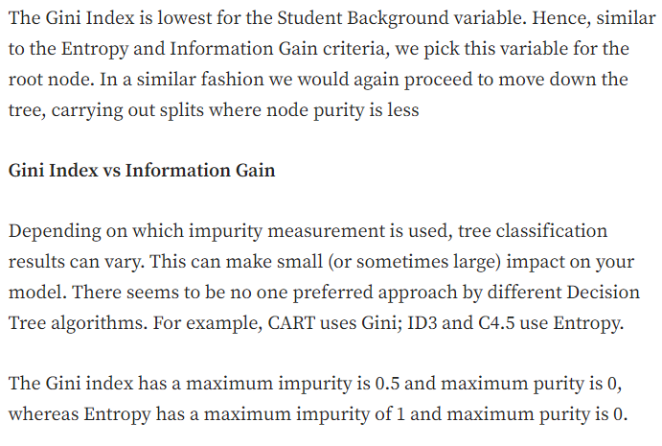
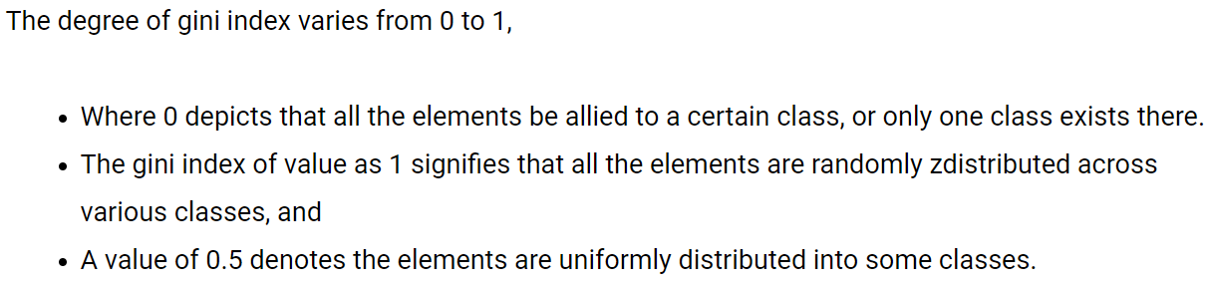

Slide 13
Pruning
Overfitting can be a big challenge with Decision Trees. Even in our toy example, we can see the algorithm continues to split till it reaches a leaf node. Often the leaf node may just have one or two instances. This will clearly lead to a complex tree structure which may not generalize well to a test scenario. This is because each leaf will represent a very specific set of attribute combinations that are seen in the training data, and the tree will not be able to classify attribute combinations not seen in the training data. There are several ways we can prevent the decision tree from becoming too unwieldy: 3 broad approaches to avoiding overfitting are distinguished:
Pre pruning or Early stopping: Preventing the tree from growing too big or deep. The pre-pruning technique involves
tuning the hyperparameters of the decision tree model prior to the training pipeline. The hyperparameters of the DecisionTreeClassifier in SkLearn include max_depth, min_samples_leaf, min_samples_split which can be tuned to early stop the growth of the tree and prevent the model from overfitting.
2) Post Pruning: Allowing a tree to grow to its full depth and then getting rid of various branches based on various criteria. A challenge with post pruning is that a decision tree can grow very deep and large and hence evaluating every branch can be computationally expensive. An important post pruning technique is Cost complexity pruning (ccp) which provides a more efficient solution in this regard.
3) Ensembling or using averages of multiple models such as Random Forest

Slide 14
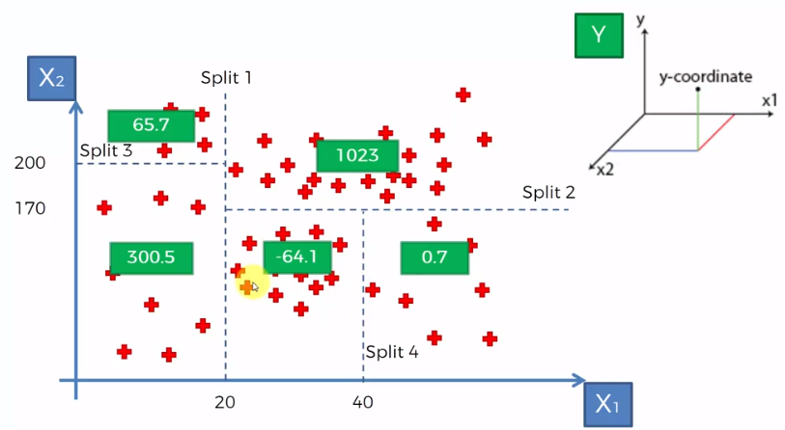
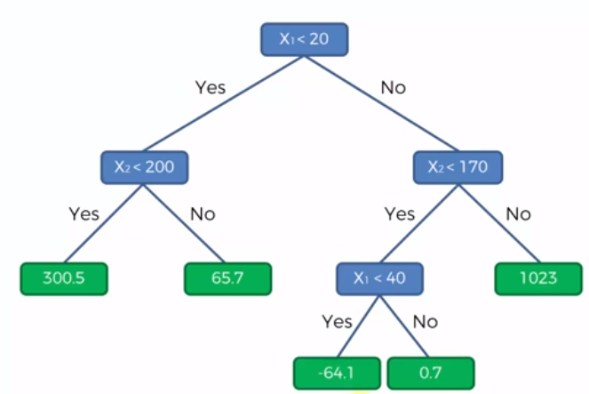
Decision Tree- Regression
The way it works is you just take the averages of each of your terminal leaves.So you take the average of y for all of these points in each terminal. Now, the value of Y for any new point will be assigned based on the average value of that terminal it falls into.

Slide 15
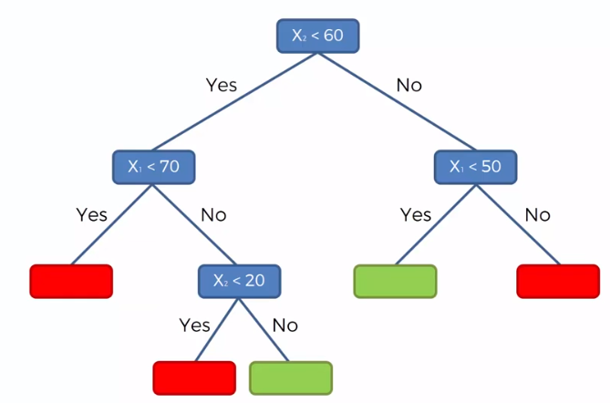
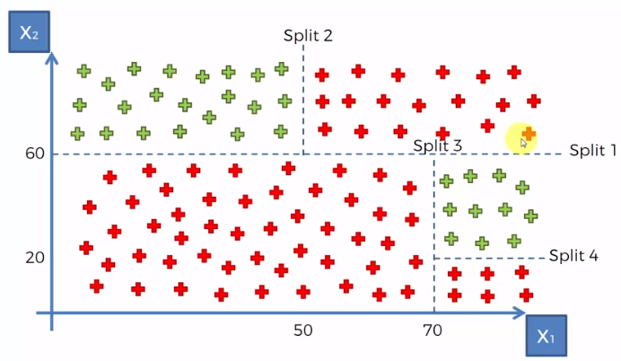
Decision Tree- Classification
If we don't go down the decision tree and check more conditions so instead of going down to the very end we can stop at any point and then just use the probabilities to predict our classification. Instead of split 4, we can stop at split 3 and based on the probability of green and red dots on the right terminal we can easily assign the terminal as green as green dots probability is more than red.

Slide 16
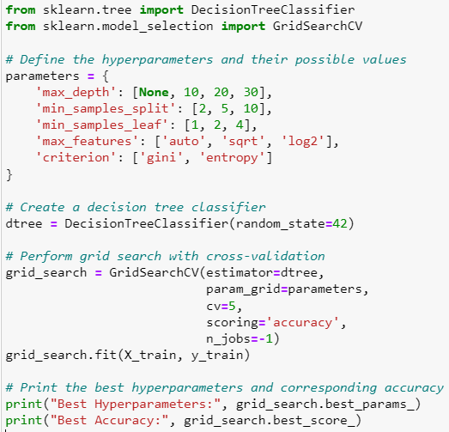
Hyper Parameter Tuning Decision Tree
N_jobs=-1 to run all processors in your machine which will optimized the grid search process

Slide 17
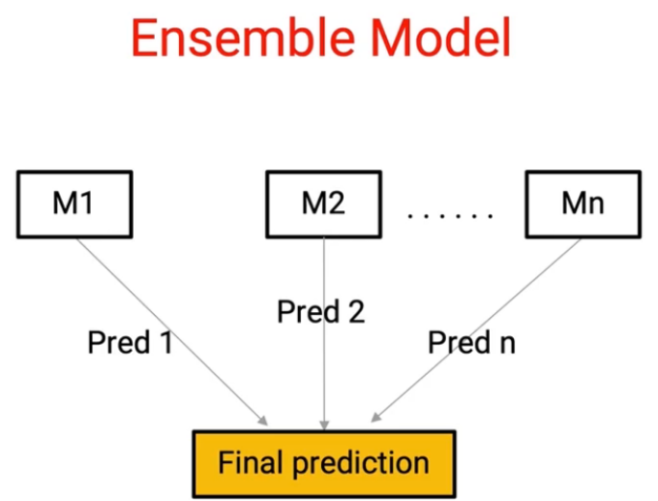
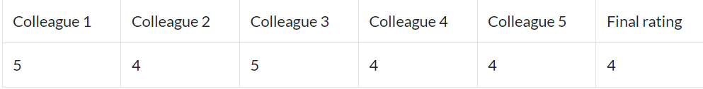
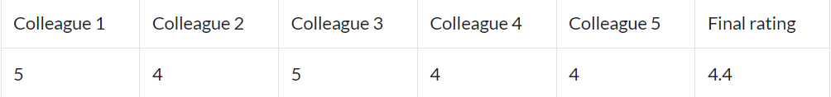
Ensemble Technique
Ensembling is nothing but the technique to combine several individual predictive models to come up with the final predictive model.
Simple Ensemble Techniques
Max Voting-
The max voting method is generally used for classification problems. In this technique, multiple models are used to make predictions for each data point. The predictions by each model are considered as a ‘vote’. The predictions which we get from the majority of the models are used as the final prediction.
For example, when you asked 5 of your colleagues to rate your movie (out of 5); we’ll assume three of them rated it as 4 while two of them gave it a 5. Since the majority gave a rating of 4, the final rating will be taken as 4. You can consider this as taking the mode of all the predictions.
The result of max voting would be something like this:
2. Averaging- Similar to the max voting technique, multiple predictions are made for each data point in averaging. In this method, we take an average of predictions from all the models and use it to make the final prediction. Averaging can be used for making predictions in regression problems or while calculating probabilities for classification problems.
For example, in the below case, the averaging method would take the average of all the values.
i.e. (5+4+5+4+4)/5 = 4.4

Slide 18
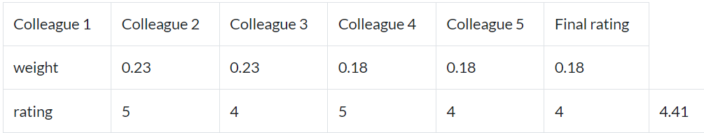
Ensemble Technique
3. Weighted Average
This is an extension of the averaging method. All models are assigned different weights defining the importance of each model for prediction. For instance, if two of your colleagues are critics, while others have no prior experience in this field, then the answers by these two friends are given more importance as compared to the other people.
The result is calculated as [(5*0.23) + (4*0.23) + (5*0.18) + (4*0.18) + (4*0.18)] = 4.41.

Slide 19
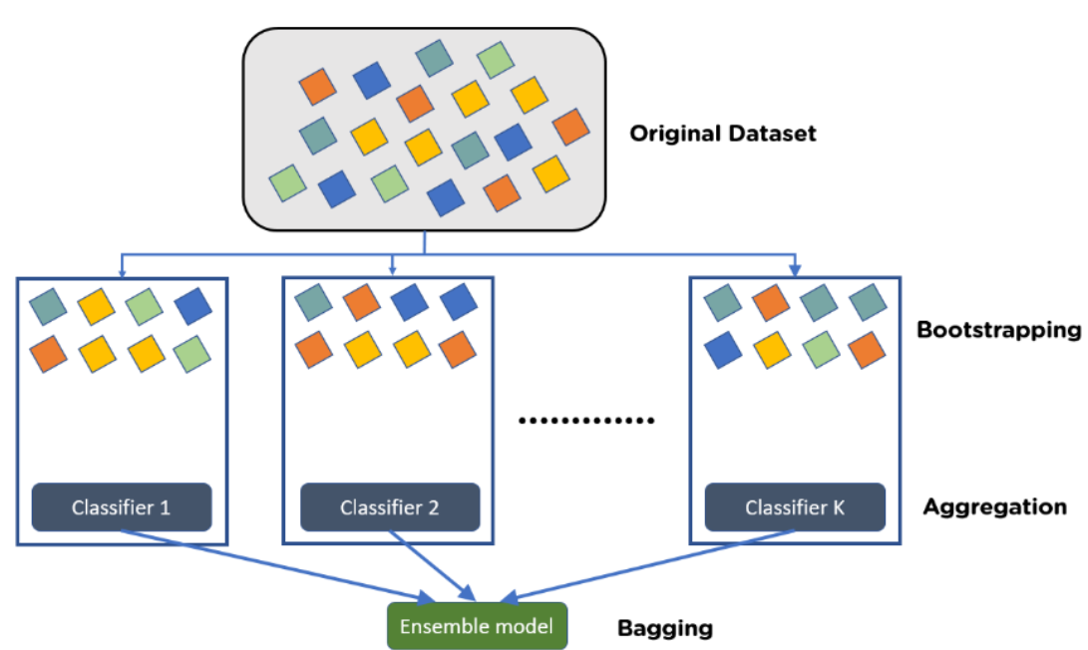
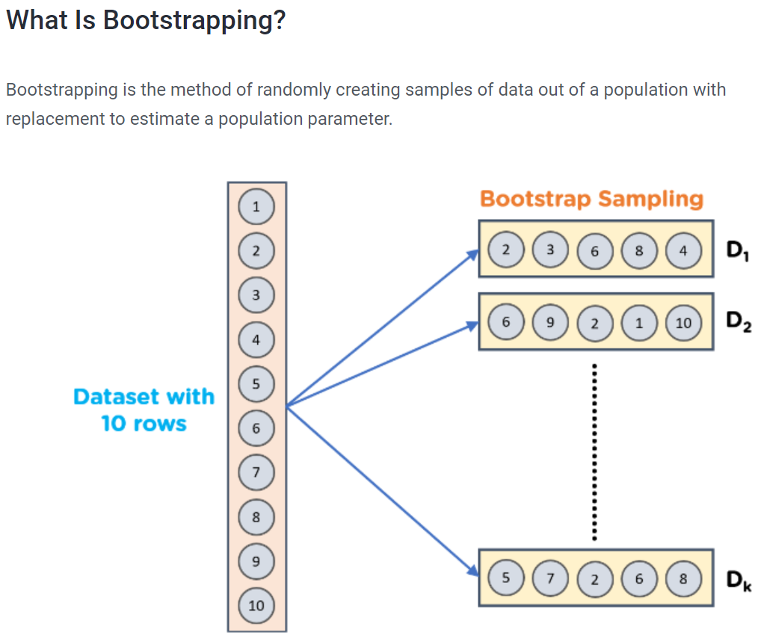
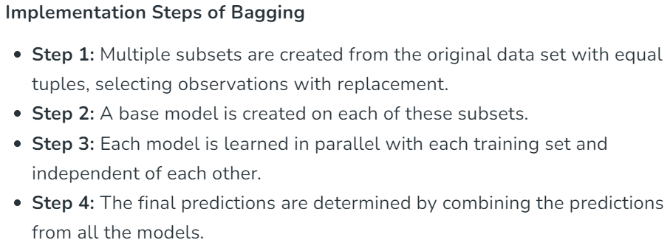
Bagging
Bagging, also known as Bootstrap aggregating, is an ensemble learning technique that helps to improve the performance and accuracy of machine learning algorithms. It is used to deal with bias-variance trade-offs and reduces the variance of a prediction model. Bagging avoids overfitting of data and is used for both regression and classification models, specifically for decision tree algorithms

Slide 20
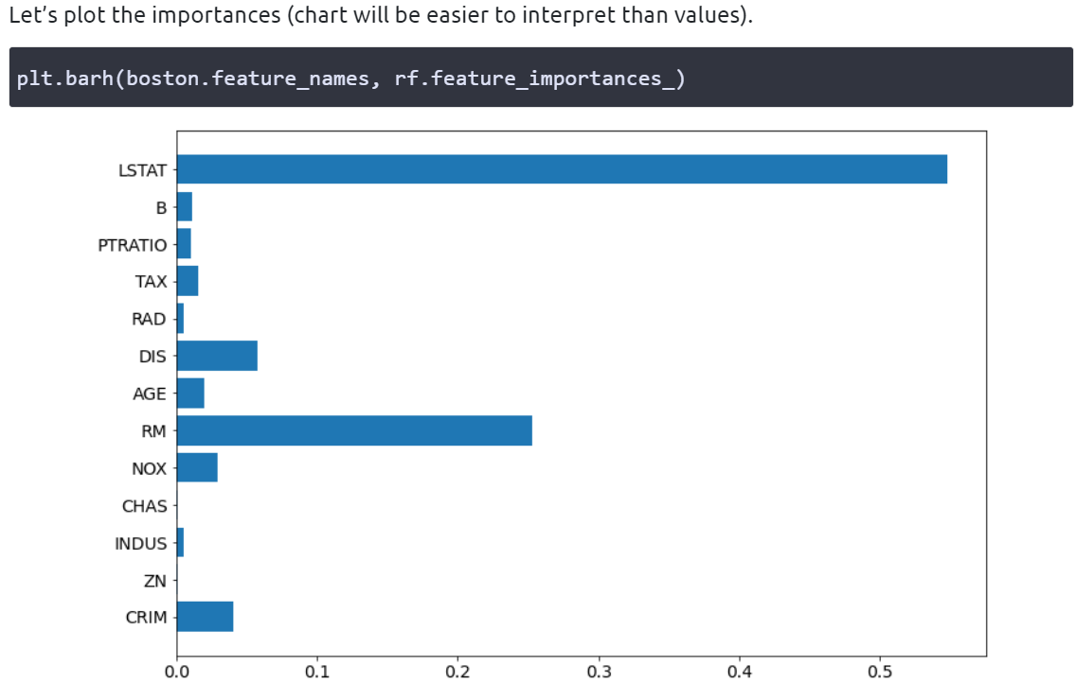
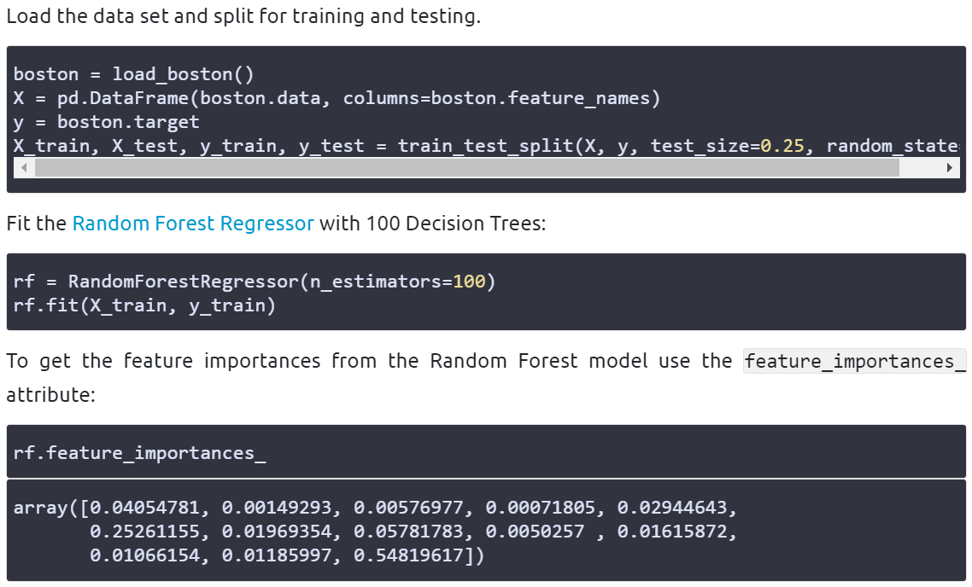
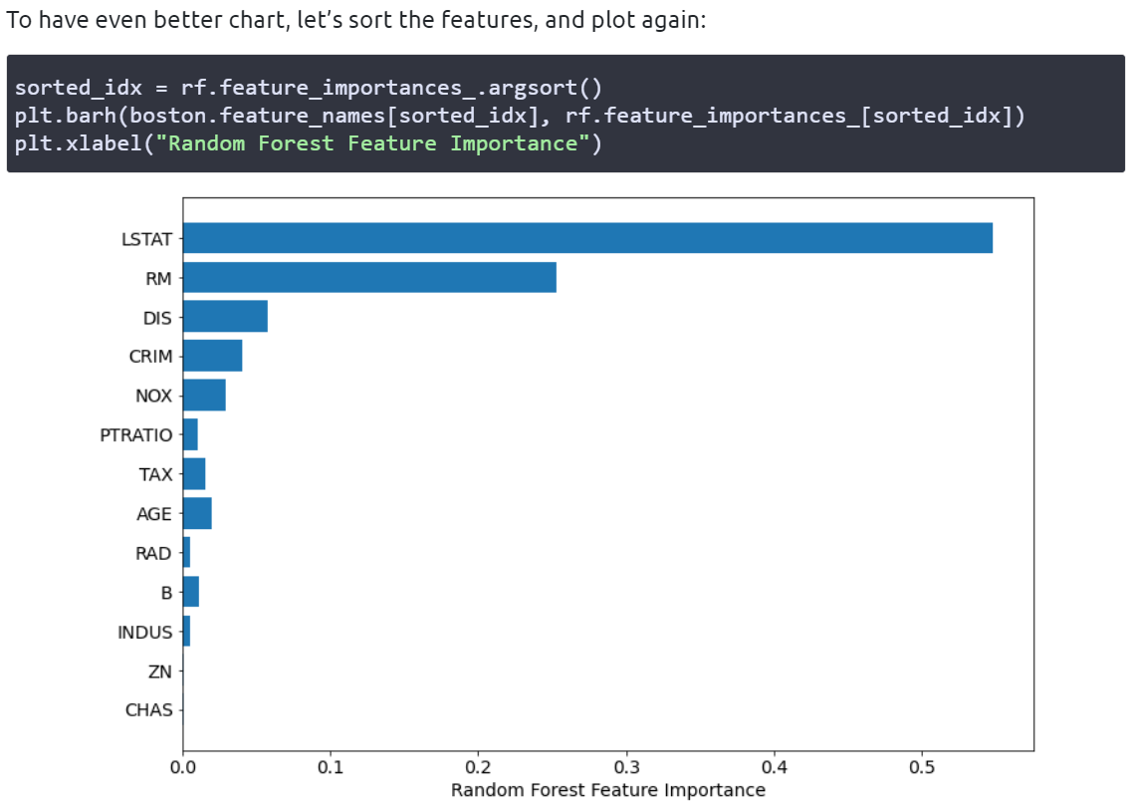
Feature Importance

Slide 21
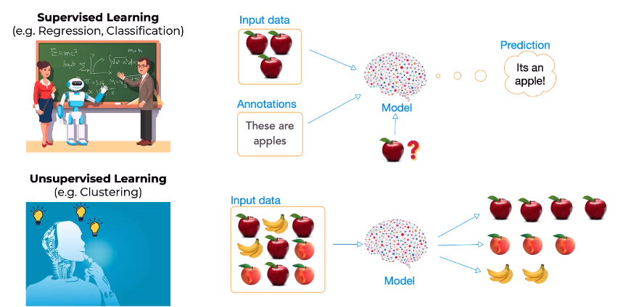
Clustering
In a nutshell, in supervised learning, you give the model an opportunity to train where it has the answers. In unsupervised learning, you don't have the answers to supply to the model.

Slide 22
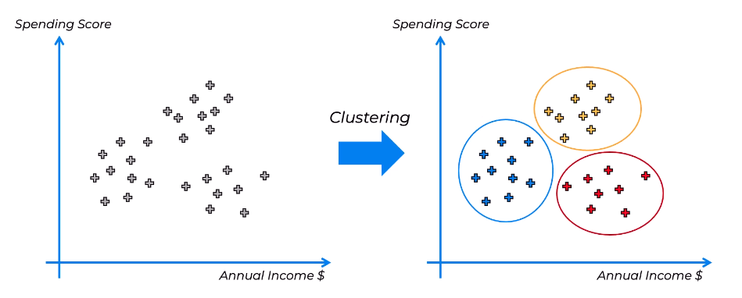
Clustering
Here we have an X Y-axis with annual income of your customers, of a store, for example and the spending score. So how often do they spend? How much do they buy? All their spending patterns. All of this is combined already into a spending score.
So when you plot your customers, it might look like above, and you don't have any preexisting categories.. You don't have any preexisting classes or groups of customers to group them into so that's where you would apply clustering to show that these are probably likely groups of customers and then you could go into this further, dig deeper and understand why these groups might be emerging, what this might be in a business sense, in a spending sense, in a customer sense, understand how to best service these customers, to what kind of promotions to send to one group versus the other, what kind of reminders or what kind of offers to create for these different customers and how to best use this information in your business.

Slide 23
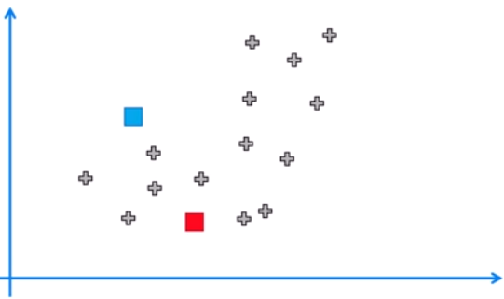
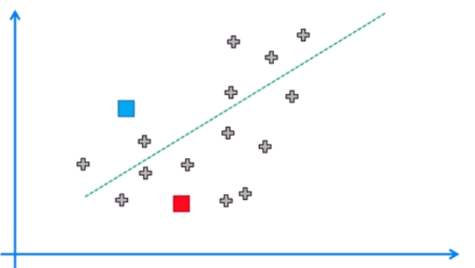
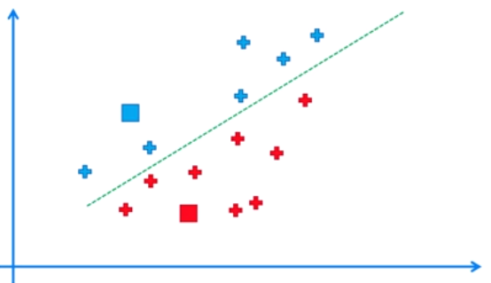
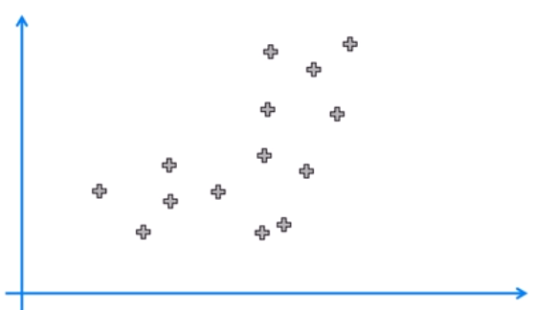
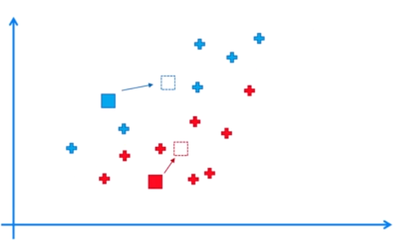
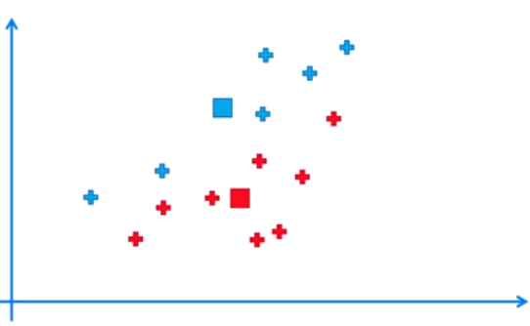
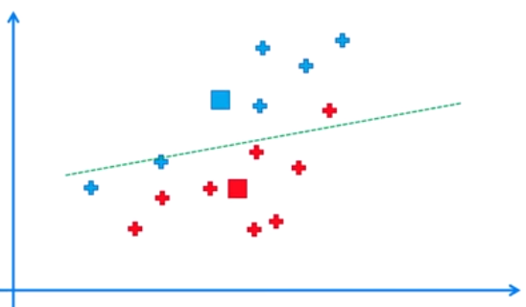
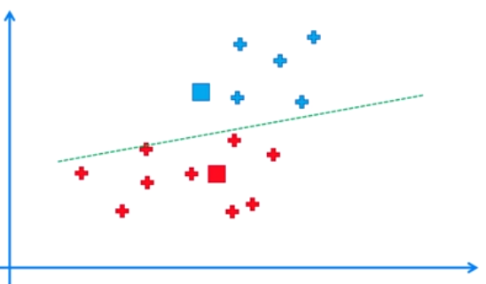
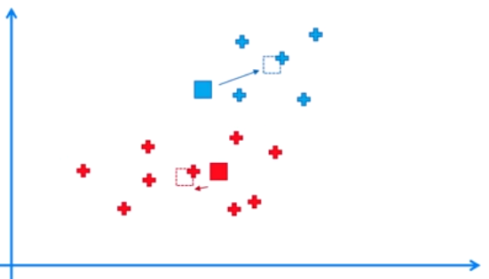
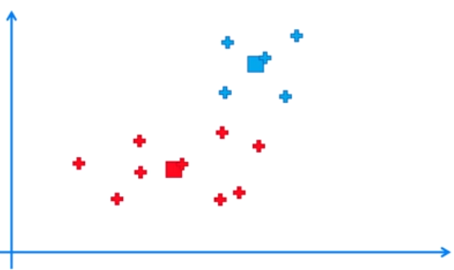
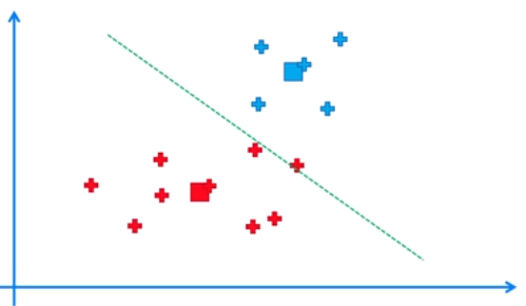
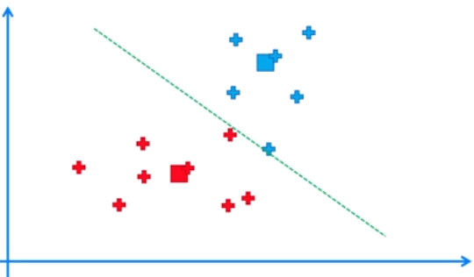
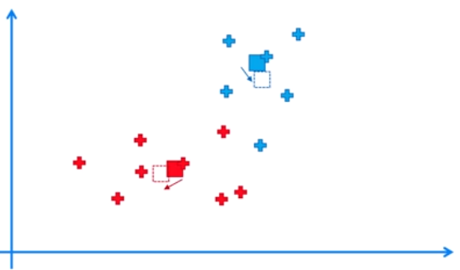
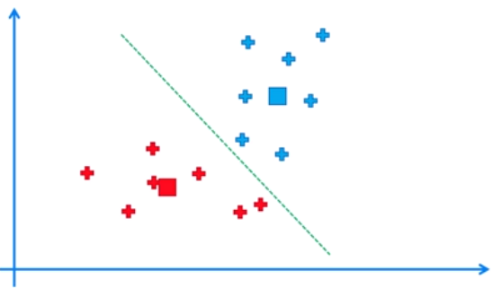


K-Means Clustering

Slide 24





Elbow Method

Slide 25



Slide 26



Silhouette Analysis

Slide 27



Silhouette Analysis

Slide 28

K-means ++
The results are different in these two runs of the same machine learning model of the k-means and they're only different because the initialization of the centroids was different. We didn't change anything else and this is called the Random Initialization Trap. It is bad because when you run a machine learning model like in this case, like clustering you want it to be deterministic means we want the result to be the same. So that's what we want to avoid and that's what K-Means ++ is designed to combat. It's basically the same as K-Means, but it adds some steps at the beginning to initialize centroids in a certain way.

Slide 29







K-means ++
Let's say that the first centroid was initialized here at random. Now what we're going to do, or what K-Means ++ will do, is it will measure the distance from every remaining data point to this centroid and then it'll take the value of the distance, and it'll square that value. So now we will select the next centroid at random but it'll be a weighted random selection. So it'll be weighted by this distance squared. So the centroid in the top right, the furthest away, has the highest chance of being picked and let's say that it was selected. Now, we do the procedure again.

Slide 30
Types of Hierarchical Clustering
Agglomerative Clustering
Agglomerative clustering is a type of hierarchical clustering algorithm that merges the most similar pairs of data points or clusters, building a hierarchy of clusters until all the data points belong to a single cluster. It starts with each data point as its own cluster and then iteratively merges the most similar pairs of clusters until all data points belong to a single cluster
Divisive Clustering
Divisive Clustering is the technique that starts with all data points in a single cluster and recursively splits the clusters into smaller sub-clusters based on their dissimilarity. It is also known as, “top-down” clustering. It starts with all data points in a single cluster, and then recursively splits the clusters into smaller sub-clusters based on their dissimilarity.

Slide 31




Hierarchical Clustering-Linkages
MIN: Also known as single-linkage algorithm can be defined as the similarity of two clusters C1 and C2 is equal to the minimum of the similarity between points Pi and Pj such that Pi belongs to C1 and Pj belongs to C2.
MAX: Also known as the complete linkage algorithm, this is exactly opposite to the MIN approach. The similarity of two clusters C1 and C2 is equal to the maximum of the similarity between points Pi and Pj such that Pi belongs to C1 and Pj belongs to C2
Group Average: Take all the pairs of points and compute their similarities and calculate the average of the similarities.
Ward’s Method: This approach of calculating the similarity between two clusters is exactly the same as Group Average except that Ward’s method calculates the sum of the square of the distances Pi and PJ.
Mathematically this can be written as,
sim(C1,C2) = ∑ (dist(Pi, Pj))²/|C1|*|C2|
Distance between centroids: Compute the centroids of two clusters C1 & C2 and take the similarity between the two centroids as the similarity between two clusters. This is a less popular technique in the real world

Slide 32


Distance Metrics

Slide 33

Distance Metrics

Slide 34

Linkage and Distance metrics Difference
Ward's method minimizes the increase in total within-cluster sum of squared error or we can say that Ward's minimum variance criterion minimizes the total within-cluster variance. This increase is proportional to the squared Euclidean distance between cluster centers. In contrast to Ward's method, our cluster distance is based on Euclidean distance, rather than squared Euclidean distance.
The linkage defines how the distances are aggregated. Without the underlying distance, there would be nothing to aggregate. Nothing to take the minimum/maximum/average of. The definitions of linkages require a distance.

Slide 35
Linkage and Distance metrics Difference
Distance or similarity metrics
Once you have preprocessed your data, you need to choose a distance or similarity metric that can capture the relationship between your data points. A distance metric measures how far apart two data points are, while a similarity metric measures how close or alike they are. There are many types of distance or similarity metrics, such as Euclidean, Manhattan, Hamming, Jaccard, or Cosine. The choice of metric depends on the type and shape of your data, as well as your clustering objective. You can also use a combination of metrics to account for different aspects of your data.
Linkage methods
After you have calculated the distance or similarity matrix for your data, you need to decide how to link or merge the data points into clusters. This is where linkage methods come in. A linkage method defines how to compute the distance or similarity between two clusters based on the distance or similarity between their members. There are several types of linkage methods, such as single, complete, average, or ward. The choice of linkage method affects the shape and size of the clusters, as well as the interpretation of the dendrogram.

Slide 36





Dendogram Working

Slide 37




Dendogram-Two clusters
Dendogram-Four clusters
Dendogram-Six clusters
Dendogram-Optimal Number of clusters

Slide 38

Knowledge Test

Slide 39

ANSWER

